Slide 1
TCP

Slide 2
What is TCP (Transmission Control Protocol)? 传输控制协议
Connection-oriented protocol: a connection is required before transmitting data.
It guarantees delivery of data to the destination with the right sequence.
Supports error checking, flow control, and acknowledgment of data.
It is heavy-weight and does not support broadcasting.
Notes:
传输控制协议 是一种面向连接的、可靠的、基于字节流的传输层通信协议

Slide 3
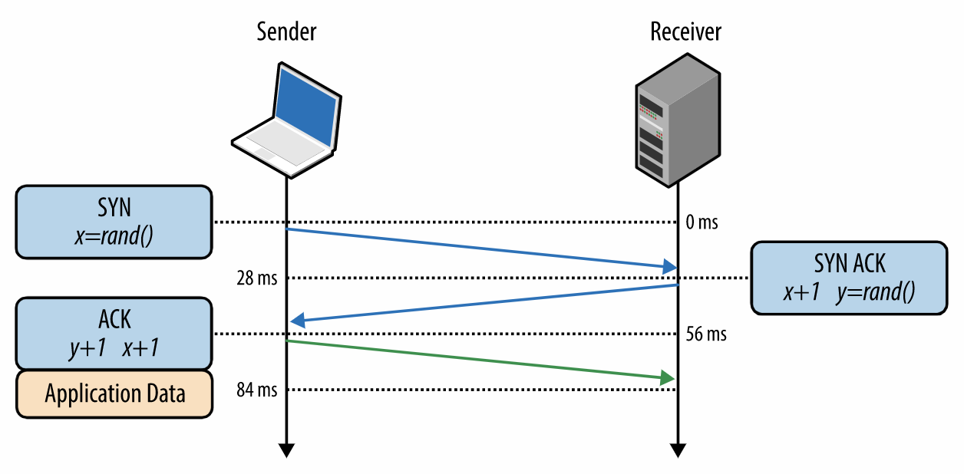
3-Way Handshake
Notes:
自己理解： Step 1 (SYN) : In the first step, client wants to establish a connection with server, so it sends a segmen分割 with SYN(Synchronize Sequence Number) which informs server that client is likely to start communication and with what sequence number it starts segments with
Step 2 (SYN + ACK): Server responds to the client request with SYN-ACK signal bits set. Acknowledgement(ACK) signifies the response of segment it received and SYN signifies with what sequence number it is likely to start the segments with
Step 3 (ACK) : In the final part client acknowledges the response of server and they both establish a reliable connection with which they will start the actual data transfer
The steps 1, 2 establish the connection parameter (sequence number) for one direction and it is acknowledged. The steps 2, 3 establish the connection parameter (sequence number) for the other direction and it is acknowledged. With these, a full-duplex communication is established.

Slide 4
UDP

Slide 5
What is UDP (User Datagram Protocol)?
An “unreliable” or “connectionless” protocol which does not receive acknowledgements for the data it transmits.
Messages may be dropped and may be delivered multiple times or out of order.
Efficient for multicasting to multiple nodes.
It has basic error checking mechanism using checksums.
Notes:
多播 (Multicast): 多播是一种群组通信，它把信息同时传递给一组目的计算机。多播可以是一对多或多对多布置。

Slide 6
Reliable Multicast with UDP
Adds loss detection and retransmission to UDP.
Example: Pragmatic General Multicast (PGM)
Notes:
实际通用多播 (Pragmatic General Multicast): 它是一个可靠的多播协议, PGM提供了一种可靠、有顺序的包传输机制给多个包接收者，使其可以应用于多接收者的文件传输等场合。

